Slide 1



Module - 6
Deep Learning

Slide 2

Disclaimer
The content is curated from online/offline resources and used for educational purpose only

Slide 3
Chapters for Discussion
Chapter - 1
Introduction to Deep Learning
Chapter - 2
Fundamentals of Neural Networks
Chapter - 3
Introduction to TensorFlow & Keras
Chapter - 4
Deep Learning Architectures & Training of Neural Networks
Notes:
Here is the chapter details we are going to discuss in this module
Chapter 1: Introduction to Deep Learning – Deep Learning is a subset of machine learning that uses neural networks to automatically learn patterns from large amounts of data.
Chapter 2: Fundamentals of Neural Networks – Neural networks are computational models inspired by the human brain, consisting of layers of interconnected nodes that process and learn from data.
Chapter 3: Introduction to TensorFlow & Keras – TensorFlow and Keras are popular deep learning frameworks that provide tools for building, training, and deploying neural networks efficiently.
Chapter 4: Deep Learning Architectures & Training of Neural Networks – Deep learning architectures include different types of neural networks, trained using optimization algorithms like gradient descent to minimize errors.

Slide 4
Chapters for Discussion
Chapter - 5
Convolutional Neural Networks (CNNs)
Chapter - 6
Recurrent Neural Networks (RNNs) & LSTMs
Chapter - 7
Transfer Learning & Pre-trained Models
Notes:
This is the continuation of chapter details Chapter 5: Convolutional Neural Networks (CNNs) – CNNs are specialized neural networks designed for image and video processing by extracting spatial features through convolutional layers.
Chapter 6: Recurrent Neural Networks (RNNs) & LSTMs – RNNs and their advanced variant LSTMs are neural networks that process sequential data by maintaining memory of past inputs, making them ideal for tasks like speech and text processing.
Chapter 7: Components of Machine Learning with Pre-Trained Models – Feature engineering, model evaluation, and pre-trained models enhance AI performance and efficiency.

Slide 5

Chapter - 3
Introduction to TensorFlow & Keras
Notes:
Welcome to the session, we already discussed first chapter, introduction to Deep Learning. Now we moving to the second chapter Fundamentals of Neural Networks.
Neural Networks are the foundation of Deep Learning, inspired by the human brain's ability to recognize patterns and make decisions. They consist of interconnected layers of artificial neurons that process information step by step. The fundamental idea is that these networks learn from data by adjusting the connections between neurons, allowing them to identify patterns, classify data, and make predictions. Neural Networks are widely used in applications like image recognition, speech processing, and natural language understanding. Understanding their structure, working principles, and training process is key to leveraging their power in AI-driven solutions.

Slide 6

Learning Objective
You will learn in this Chapter:
Learn what TensorFlow is and understand its key benefits in building machine learning models.
Understand how Keras simplifies neural network development as TensorFlow’s high-level API.
Install TensorFlow and set up a working environment for developing ML applications.
Explore how to create and manipulate tensors using basic TensorFlow operations.
Understand the concept, structure, and types of tensors used in TensorFlow.
Notes:
The trainer will discuss the topics we are covering in this unit
In this session, our focus will be on getting familiar with TensorFlow and its core concepts. By the end of this session, you’ll be able to understand what TensorFlow is and why it's widely used in the field of machine learning. We’ll also explore Keras as a high-level API and see how it simplifies building deep learning models. Next, we’ll walk through the installation and setup process to get TensorFlow up and running on your system. Once that’s done, we’ll dive into the concept of tensors, which are the building blocks of TensorFlow, and perform some basic operations on them. This foundational knowledge will prepare you to start working on actual models in the upcoming sessions.

Slide 7








What is TensorFlow?
Open-source library developed by Google
Designed for deep learning and supports traditional ML
Enables distributed computing across CPUs/GPUs
Uses data flow graphs with nodes and edges
Works with multi-dimensional data structures called tensors
Notes:
Today, we are discussing about TensorFlow
TensorFlow is a powerful open-source library developed by Google, primarily to support deep learning, although it also accommodates traditional machine learning tasks.
One of the key reasons for its effectiveness is how it handles data—through tensors, which are essentially multi-dimensional arrays. These tensors make it easier to manage and compute large amounts of data, which is especially important in real-world AI problems.
Another unique aspect of TensorFlow is its architecture. It uses data flow graphs, where the nodes represent operations and the edges represent the data—this data being tensors.
Thanks to this graph-based execution, TensorFlow code can be distributed efficiently across multiple CPUs or GPUs—even on clusters of machines. This makes it extremely scalable and ideal for training large models.

Slide 8
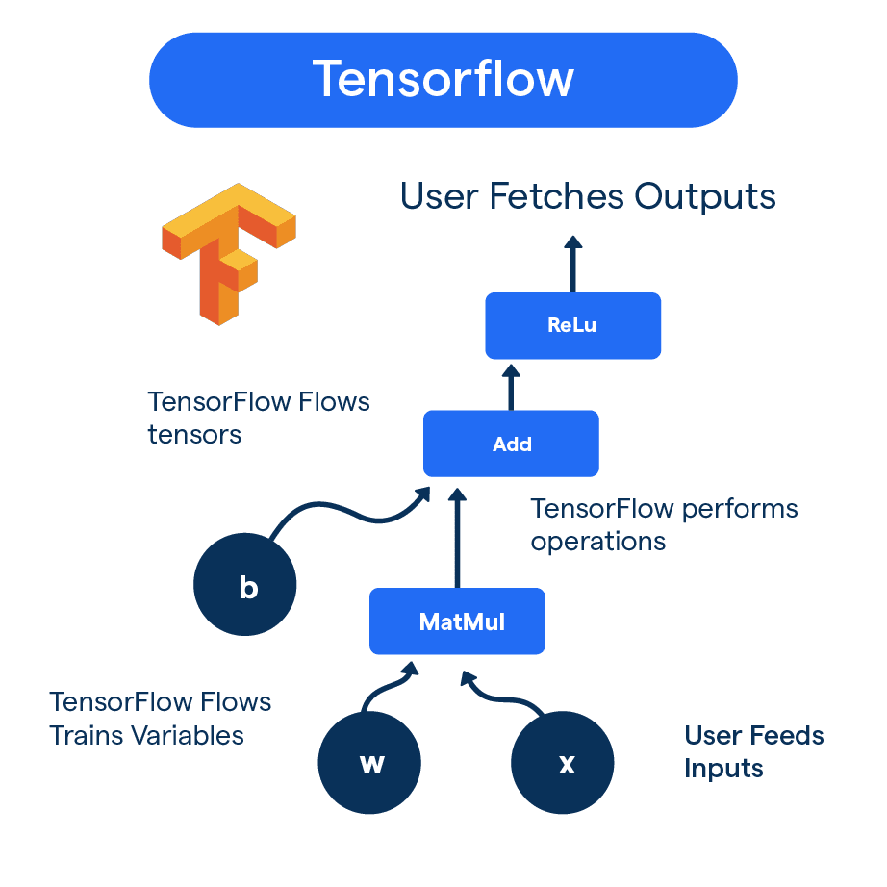
How TensorFlow Works
Key components are Data Preprocessing, Model Construction, Model Training
Operates using:
Computational Graphs (dataflow-based)
Eager Execution (runs operations immediately)
Uses tensors (multi-dimensional arrays) for computation
Supports execution on CPUs, GPUs, desktops, mobile & cloud
Tools:
TensorBoard – visualizes training process and performance
Keras API – simplifies model building and experimentation
Source
https://botpenguin.com/glossary/tensorflow
Notes:
Trainer can explain How Do Neurons Operate in a Neural Network?
Neurons in a neural network function similarly to biological neurons. They receive inputs from multiple neurons in the previous layer through synapses, each connection having an assigned weight.
The weight determines the importance of the input - higher weights contribute more to the final output. Once the neuron receives all inputs, it calculates the weighted sum and passes the result through an activation function. This function decides whether the neuron should "fire" and transmit its signal to the next layer.
The key to deep learning is adjusting these weights during training to minimize errors and improve accuracy. The process of fine-tuning these weights, called backpropagation, ensures the model learns from data effectively.

Slide 9
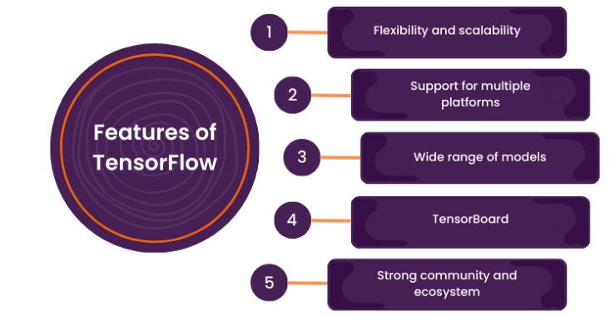
Why use TensorFlow?
Flexible & Powerful platform for ML model building and deployment
Simplified development with Keras API
Advanced features: Eager Execution & Distributed Training
Seamless deployment on Cloud, Mobile, Edge, Web
Supports production pipelines with TFX, mobile optimization with TensorFlow Lite, and web deployment with TensorFlow.js
Rich tools for research: Functional API, Model Subclassing, and Pre-trained Models
Source
https://botpenguin.com/glossary/tensorflow
Notes:
Trainer can elaborate Why should we choose TensorFlow among the many frameworks available?
First, TensorFlow is both powerful and flexible, ideal for beginners just getting started and researchers pushing the boundaries of AI. The Keras API makes model development faster and easier with high-level building blocks, while still offering low-level control when needed.
TensorFlow supports eager execution for easier debugging, and distributed training, allowing models to scale across multiple GPUs or machines.
Deployment is where TensorFlow shines—it works across cloud, mobile, edge, and web platforms. You can go from model training to real-world applications with TensorFlow Lite for mobile apps, TFX for end-to-end ML pipelines, and TensorFlow.js for deploying models in browsers.
For researchers, there’s the Keras Functional API for flexible model architecture, Model Subclassing for custom logic, and access to pre-trained models for faster prototyping.
And finally, TensorFlow is backed by a strong community, constant updates, and support for diverse hardware. It’s a one-stop solution whether you're building your first model or experimenting with cutting-edge research.

Slide 10

Keras as a High-Level API
High-level API of TensorFlow for easy deep learning model development
Simple & Modular: Ideal for rapid experimentation
Cross-platform support: Compatible with CPUs, GPUs, TPUs, and mobile
Rich library of predefined components: Layers, optimizers, loss functions
Multiple model-building options: Sequential, Functional API, Subclassing
Built-in training methods: fit(), evaluate(), predict()
Efficient data preprocessing tools for images, text, and numbers
Source
https://keras.io/
Notes:
Trainer can introduce Keras as a High-Level API
Keras is like the friendly front-end of TensorFlow - it’s a high-level API built to make deep learning development more intuitive and beginner-friendly.
Its simple and modular design allows you to prototype models quickly and efficiently. This is great when you're experimenting with different architectures or tuning hyperparameters.
It’s also cross-platform, so you can build models on your local machine using a CPU and then scale up effortlessly to GPUs, TPUs, or even deploy on mobile.
Keras comes loaded with predefined components - you don’t need to write custom code for layers, optimizers, or loss functions unless you want to.
When it comes to building models, you’ve got options. The Sequential API is perfect for straightforward layer stacks. The Functional API helps you create more complex architectures like branching models or multi-input systems. And if you need full flexibility, Model Subclassing gives you total control over the logic.
Keras also simplifies training with ready-to-use methods like fit(), evaluate(), and predict(). And lastly, Keras provides robust data preprocessing tools for handling all types of data - text, images, and numbers - making the whole ML pipeline easier.

Slide 11

Key Features of Keras
Cross-Platform Scalability: Runs on various hardware, including CPUs, GPUs, TPUs, and mobile devices.
Predefined Components: Offers a large set of built-in layers, loss functions, optimizers, and activation functions.
Multiple Model APIs: Supports Sequential API for simple layer stacking, Functional API for complex architectures, and Model Subclassing for full customization.
Built-in Training Methods: Includes fit(), evaluate(), and predict() for efficient model training and evaluation.
Data Preprocessing: Provides tools for handling images, text, and numerical data efficiently.
Source
https://www.researchgate.net/figure/llustrative-image-of-artificial-neural-networks-with-their-working-mechanism-as-like_fig13_380136894
Notes:
Trainer can explain Key Features of Keras
Let’s talk about what makes Keras one of the most popular APIs for deep learning.
First, simplicity and modularity—Keras allows you to build, test, and iterate on models quickly. It's great for both beginners and researchers who want to prototype without heavy code.
It supports cross-platform scalability, so whether you're training on a CPU, GPU, TPU, or even deploying to a mobile device, Keras has you covered.
Keras is packed with predefined components—you get ready-to-use layers like Dense or Conv2D, common loss functions like binary_crossentropy, and optimizers like Adam or SGD. This saves a ton of coding time.
It offers multiple APIs for building models. The Sequential API is great for beginners—it allows you to stack layers one after the other. For more advanced use cases, the Functional API lets you build complex models like multiple input/output systems. If you need complete control, Model Subclassing allows you to write your own model logic.
Training is also super convenient with Keras. Methods like fit() train your model, evaluate() helps you assess accuracy, and predict() generates results—all with clean and readable syntax.
Lastly, Keras comes with powerful data preprocessing tools. You can efficiently handle and transform image data, text sequences, or numerical values before feeding them into models.
These features make Keras not only flexible but also efficient and production-ready

Slide 12
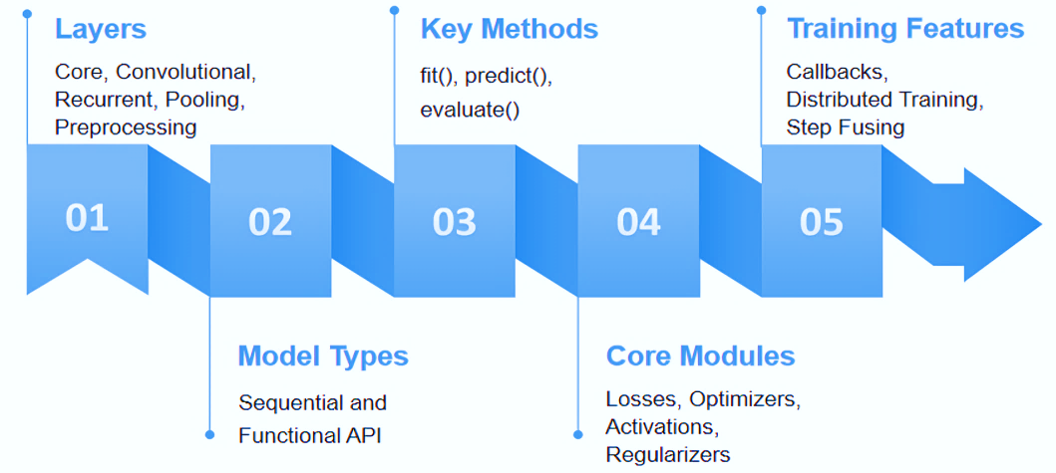
Keras API Components
Notes:
Trainer can elaborate Keras API Components
Let’s explore the key components that make Keras so efficient and user-friendly for building deep learning models.
First, we have Layers, the fundamental building blocks. Keras offers a variety—from basic Dense layers to advanced types like convolutional layers for image tasks, recurrent layers for sequence data, and preprocessing layers to handle text and normalization.
Next are Models. Keras provides two main APIs:
The Sequential API is ideal for beginners building simple, linear models.
The Functional API is perfect for complex models with branching, shared layers, or multiple inputs and outputs. With both, you get handy built-in methods like fit(), predict(), and evaluate().
Then we have Core Modules. These include loss functions like mean_squared_error and categorical_crossentropy, various optimizers to improve learning efficiency, and activation functions like ReLU and Softmax that decide neuron behavior. Regularizers like L1 and L2 help reduce overfitting.
Finally, Keras enhances training with powerful features like Callbacks—these automate tasks such as stopping training early or saving the best model. Keras also supports distributed training across GPUs/TPUs and step fusing for performance optimization during large-scale training.
All these components come together to make Keras a robust yet simple tool for deep learning development

Slide 13
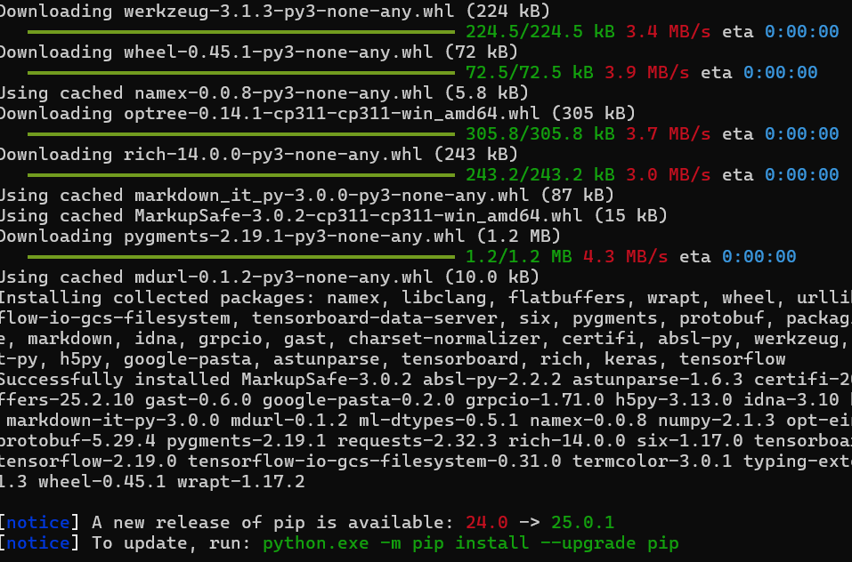
TensorFlow Installation & Setup
Check if pip is installed (pip --version)
(Optional) Create virtual environment (python -m venv tensorflow_env)
Activate environment (activate on Windows / source on macOS/Linux)
Upgrade pip (pip install --upgrade pip)
Install TensorFlow (pip install tensorflow)
Verify installation (import tensorflow as tf, print(tf.__version__))
Notes:
Trainer can mention TensorFlow Installation & Setup
First, check if pip is available using pip --version. It usually comes with Python.
For clean project management, I recommend creating a virtual environment using python -m venv tensorflow_env.
Activate it—use the appropriate command depending on your operating system.
Upgrade pip to avoid any compatibility issues with packages.
Install TensorFlow with a simple pip install tensorflow. This will fetch the latest stable release.
Finally, verify the installation by importing TensorFlow in Python and checking the version using tf.__version__.
This setup ensures your system is ready for TensorFlow-based deep learning projects.

Slide 14
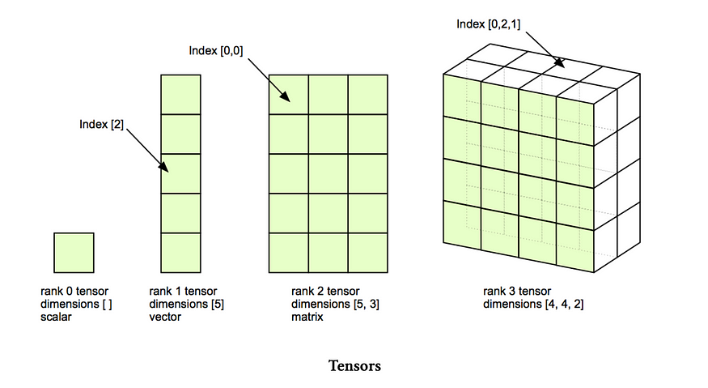
What is a Tensor?
Tensors generalize scalars, vectors, and matrices
Multi-dimensional arrays that transform under coordinate changes
Used to describe direction-dependent physical quantities
Rank defines type:
Rank 0: Scalars (e.g., temperature)
Rank 1: Vectors (e.g., force)
Rank 2: Matrices (e.g., stress, strain)
Source
https://ai.plainenglish.io/what-is-a-tensor-2715746a4785
Notes:
Trainer will discuss What is a Tensor?
Let’s understand what a tensor really is.
A tensor is like an upgraded version of scalars, vectors, and matrices—it can be seen as a multi-dimensional array.
What sets tensors apart is their behavior under coordinate changes, which makes them valuable for describing physical phenomena that depend on direction—like force or stress.
The rank or order of a tensor tells us what kind of object it is:
Rank 0: Scalar – just a single value, no direction.
Rank 1: Vector – has direction and magnitude.
Rank 2: Matrix – can represent more complex relations, like how stress spreads across a surface.
Tensors are the foundation of many scientific fields—physics, machine learning, and especially deep learning where data comes in high-dimensional forms (like images, which are 3D tensors).

Slide 15
Creating Tensors in TensorFlow
tf.constant()
tf.Variable()
Example:
w = tf.Variable([[1.0, 2.0], [3.0, 4.0]])
w.assign([[5.0, 6.0], [7.0, 8.0]]) # update values
Variables are central to model training because they allow learning and adjustment over time.
Example,
c = tf.constant([1, 2, 3], dtype=tf.int32)
This is ideal when the tensor represents data that should remain constant.
tf.zeros() and tf.ones()
tf.random() Functions
Examples:
z = tf.zeros([3, 3])
o = tf.ones([2, 4])
They are especially useful when you need a tensor with a specific shape but neutral values.
Example:
r = tf.random.normal([2, 3], mean=0, stddev=1)
Random initialization ensures models learn efficiently and converge faster.
Notes:
TensorFlow provides a variety of functions to create different types of tensors, which are the basic data structures used throughout machine learning workflows. Understanding how to initialize and work with tensors is essential because they hold the input data, model parameters, and intermediate computations in neural networks.
tf.constant()
tf.constant() is used to create immutable tensors, meaning their values cannot be changed once created. These are useful for storing fixed information such as configuration parameters, predefined arrays, or values that should not be updated during training.
tf.Variable()
tf.Variable() creates mutable tensors, typically used to store trainable parameters like weights and biases in deep learning models. Their values can be updated using .assign() operations or automatically during backpropagation and optimization.
tf.zeros() and tf.ones()
These functions create tensors filled entirely with zeros or ones. They are commonly used for initializing placeholders, padding, and sometimes for initializing model parameters.
tf.random() Functions
TensorFlow provides random tensor generation functions like tf.random.normal() and tf.random.uniform(). These are often used to initialize model weights with small random values, which helps avoid symmetry issues in neural networks.
Overall, these TensorFlow tensor creation methods provide flexible ways to define data, initialize neural networks, and build complex machine learning pipelines.

Slide 16
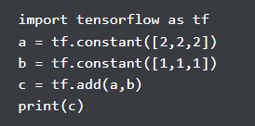
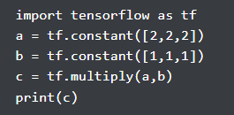
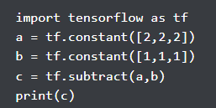
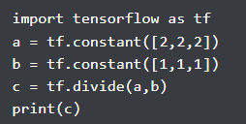

TensorFlow Operations
Arithmetic Operations on Tensors
Notes:
TensorFlow operations often called ops are the fundamental building blocks used to perform computations on tensors. Every mathematical function, transformation, or neural network layer in TensorFlow is executed using one or more operations. An operation can take zero or more tensors as input, perform a computation, and produce one or more output tensors. Because TensorFlow uses a computation graph structure, these ops can run efficiently on CPUs, GPUs, or TPUs.
Addition - we can add two or more tensors in tensorflow using “tf.add” function.
Subtraction - we can subtract one tensor from other in tensorflow using “tf.subtract” function.
Multiplication - we can perform multiplication on two or more tensors in tensorflow using “tf.multiply” function.
Division - we can perform Division on two tensors in tensorflow using “tf.divide” function.

Slide 17
TensorFlow Operations - Element-Wise and Matrix Operations
Element-Wise Operations
Matrix Operations
Example:
import tensorflow as tf
a = tf.constant([2, 4, 6])
b = tf.constant([1, 3, 5])
add_result = a + b # [3, 7, 11]
mul_result = a * b # [2, 12, 30]
relu_result = tf.nn.relu(a) # [2, 4, 6]
Element-wise operations are heavily used in neural networks during feature scaling, activation application, and intermediate transformations.
Example:
m1 = tf.constant([[1, 2], [3, 4]])
m2 = tf.constant([[5, 6], [7, 8]])
matmul_result = tf.matmul(m1, m2)
transpose_result = tf.transpose(m1)
Matrix operations allow TensorFlow models to learn patterns by mapping input vectors to new feature spaces through linear transformations.
Notes:
TensorFlow provides two major categories of mathematical computations on tensors: element-wise operations and matrix operations. Both are essential in deep learning because they support everything from simple arithmetic to complex layer transformations.
Element-Wise Operations
Element-wise operations apply mathematical functions to each element of a tensor independently. These operations require tensors to be of the same shape or broadcastable to a common shape. Examples include addition, subtraction, multiplication, division, exponentiation, and activation functions like ReLU and sigmoid.
Matrix Operations
Matrix operations involve computations across rows and columns. These include matrix multiplication, dot products, transposition, and determinant computations. Matrix multiplication is especially important because every dense layer in a neural network uses it.

Slide 18
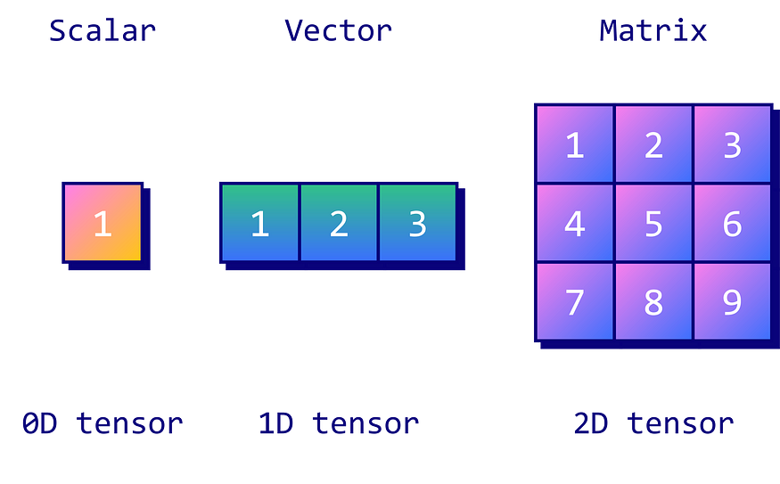
Scalars
In TensorFlow, a scalar can be created using:
import tensorflow as tf
scalar = tf.constant(5)
Scalars can participate in arithmetic operations just like any number. When involved in tensor operations, scalars automatically broadcast to match the shape of the operand. For instance:
v = tf.constant([1, 2, 3])
result = v + scalar # adds 5 to each element
Notes:
A scalar is the simplest form of numerical data used in mathematics, machine learning, and TensorFlow. It represents a single value with no dimensions. Because it has no direction, magnitude, shape, or axes, it is considered a rank-0 tensor. Scalars often represent learning rates, loss values, temperature readings, or any quantity that can be expressed as one fixed numerical point. In neural networks, scalars appear frequently—for example, the loss after each training step is a scalar, as is a single prediction score when output size is one.

Slide 19
Vectors
In TensorFlow, a vector can be created as:
vector = tf.constant([1, 2, 3, 4])
Vectors support element-wise operations and broadcasting when combined with scalars or matrices.
scaled = vector * 2 # multiplies each element by 2
Vectors can represent directions in space, allowing operations like dot product and cosine similarity important concepts in deep learning models like word2vec, BERT, or recommendation systems. For example:
v1 = tf.constant([1.0, 2.0, 3.0])
v2 = tf.constant([4.0, 5.0, 6.0])
dot = tf.tensordot(v1, v2, axes=1)
Notes:
Vectors
A vector is a one-dimensional array of numbers representing magnitude and direction. In tensor terminology, a vector is a rank-1 tensor. Vectors are commonly used to represent features, weights, word embeddings, and probability distributions in machine learning. For example, a student’s marks in four subjects—[85, 76, 90, 88]—form a vector. Similarly, RGB color values such as [255, 100, 50] are also vectors.

Slide 20
Matrices
In TensorFlow:
matrix = tf.constant([[1, 2], [3, 4]])
Matrix operations include element-wise operations, matrix multiplication, transposition, and reshaping.
matmul = tf.matmul(matrix, matrix)
transposed = tf.transpose(matrix)
Matrices allow relationships across multiple variables to be represented simultaneously.
For example, a dataset with 5 samples and 3 features can be stored in a 5×3 matrix, where rows represent samples and columns represent features.
Matrix multiplication is especially crucial in deep learning. Every layer in a neural network performs an operation like:
output = input × weights + bias
Notes:
Matrices
A matrix is a two-dimensional grid of numbers arranged in rows and columns. It is a rank-2 tensor and is fundamental to linear algebra, machine learning, and deep learning. Matrices allow representation of structured information—for example, a grayscale image of size 28×28 can be represented as a matrix, where each cell contains a pixel intensity value. Matrices are also used as weight layers in neural networks, where input vectors are multiplied by weight matrices to perform transformations.

Slide 21
Higher-Dimensional Tensors
Example (batch of 32 RGB images, each 28×28):
tensor4d = tf.random.normal([32, 28, 28, 3])
Higher-dimensional tensors organize data across multiple axes.
Axis 0: batch
Axis 1: height
Axis 2: width
Axis 3: channels
These tensors enable deep learning models like CNNs, RNNs, and Transformers to extract features across different spatial or temporal dimensions.
You can index them like:
first_image = tensor4d[0]
red_channel = tensor4d[0, :, :, 0]
Notes:
Higher-Dimensional Tensors
Higher-dimensional tensors extend the idea of vectors (1D) and matrices (2D) into 3D, 4D, or even N dimensions. They represent complex, structured data such as images, video, text sequences, or batches of examples. A rank-3 tensor might represent an image (height × width × channels). A rank-4 tensor may represent a batch of images, while rank-5 tensors can represent video sequences.
Higher-rank tensors allow models to handle complex inputs such as sequences of word embeddings (N × sequence_length × embedding_dim) or video frames (batch × frames × height × width × channels). Their flexibility enables deep learning systems to process real-world data in structured and meaningful ways.

Slide 22
Differences between Scalars, Vectors, Matrices, and Tensors
The key difference is the amount of information and structure each can represent.
A scalar holds one value.
A vector holds multiple values along a single axis.
A matrix holds data aligned across two axes.
A tensor generalizes matrices to multiple axes.
In TensorFlow:
scalar: tf.constant(5)
vector: tf.constant([1,2,3])
matrix: tf.constant([[1,2],[3,4]])
tensor: tf.random.normal([32,28,28,3])
Mathematically, each is a superset of the previous:
scalars → vectors → matrices → tensors.
Notes:
Differences Between Scalars, Vectors, Matrices, and Tensors
Scalars, vectors, matrices, and higher-dimensional tensors differ primarily in rank, shape, and complexity. A scalar is the simplest: a single number with no dimensions (rank-0). A vector adds one dimension (rank-1) and represents an ordered list of values. A matrix introduces two dimensions (rank-2), providing a structured grid with rows and columns. Higher-dimensional tensors extend this concept to 3D, 4D, or N-dimensional structures.
In machine learning, scalars represent losses and hyperparameters, vectors store features, matrices contain datasets or weight layers, and tensors store images, text sequences, or batched data. Understanding these differences helps structure data correctly and feed it into models efficiently.

Slide 23
Reshaping and Transposing Tensors in TensorFlow
Reshaping Tensors with tf.reshape()
Automatic Dimension Inference (-1)
TensorFlow allows one dimension to be set to -1, meaning “calculate automatically.”
x = tf.range(12)
reshaped = tf.reshape(x, [-1, 6])
TensorFlow infers that the missing dimension is 2, because 12 ÷ 6 = 2. Resulting shape: (2, 6)
Basic Reshaping,
import tensorflow as tf
x = tf.range(12) # [0, 1, 2, ..., 11]
reshaped = tf.reshape(x, [3, 4])
Here:
Original shape: (12,)
New shape: (3, 4)
Reshaping for Neural Networks
Images are often stored as 3D tensors (height, width, channels), but dense (fully connected) layers require 1D vectors.
image = tf.random.normal([28, 28, 1]) # grayscale image
flat = tf.reshape(image, [784]) # flattening
Notes:
Reshaping Tensors with tf.reshape()
Reshaping changes the shape of a tensor without altering its underlying data. You modify how data is organized, not what the values are. For example, a 1D tensor with 12 elements can be reshaped into a 3×4 matrix, a 2×2×3 tensor, or any shape where the total number of elements remains constant.
This is extremely useful when:
Preparing input batches for neural networks
Converting image data between flattened and structured forms
Aligning outputs from layers such as CNNs, RNNs, or embeddings
Managing sequence data or time-series formats

Slide 24
Reshaping and Transposing Tensors in TensorFlow
Transposing Tensors with tf.transpose()
Transposing Higher-Dimensional Tensors
Basic Matrix Transpose
m = tf.constant([[1, 2, 3],
[4, 5, 6]])
t = tf.transpose(m)
Original shape: (2, 3) Transposed shape: (3, 2)
A 3D tensor (batch, height, width) can be rearranged:
tensor3d = tf.random.normal([10, 28, 28])
t = tf.transpose(tensor3d, perm=[0, 2, 1])
The perm argument defines how axes are reordered. Here, height and width axes are swapped.
Notes:
Transposing Tensors with tf.transpose()
Transposing changes the order of tensor dimensions, effectively reorienting data. This operation is widely used in:
Matrix algebra
Convolutional neural networks
RNNs and transformers
Image processing
Batch reordering
Unlike reshaping, transposing does not change total elements or dimension sizes—only their positions.
Reshaping and transposing are fundamental tensor operations in TensorFlow. tf.reshape() helps align and structure data properly for model layers, while tf.transpose() ensures data is in the correct orientation for mathematical operations. Mastering both operations is essential for building efficient, flexible deep learning pipelines.

Slide 25
Slicing and Indexing Tensors in TensorFlow
Extracting elements using indexing
Using tf.slice()
Extracts a continuous block (slice) from a tensor.
You specify:
start position
size (how many elements to extract)
Syntax: tf.slice(tensor, begin, size)
Example:
x = tf.constant([[1, 2, 3],
[4, 5, 6],
[7, 8, 9]])
tf.slice(x, [0, 1], [2, 2])
# → [[2, 3],
# [5, 6]]
Using tf.gather()
Used to extract elements along a specific axis using index values.
Often used when you need non-consecutive or repeated indices.
Syntax:
tf.gather(tensor, indices, axis=0)
Example:
x = tf.constant([10, 20, 30, 40])
tf.gather(x, [0, 2]) # → [10, 30]
Notes:
Extracting elements using indexing
Access specific elements of a tensor using Python-style indexing.
Works for scalars, vectors, matrices, and higher-dimensional tensors.
Examples:
tensor[0] → first element
tensor[1:4] → slice from index 1 to 3
tensor[:, 2] → all rows, column 2
tensor[1:3, 0:2] → sub-matrix

Slide 26
GPU Acceleration & Tensor Placement
Checking GPU availability in TensorFlow
The most common method is:
import tensorflow as tf
tf.config.list_physical_devices('GPU')
This command returns a list of detected GPUs. If the list is empty, TensorFlow is either not configured for GPU support or no GPU is available. To simply check the count of detected GPUs:
print("GPUs Available:", len(tf.config.list_physical_devices('GPU')))
To view all devices—including CPUs and GPUs—TensorFlow offers:
tf.config.list_physical_devices()
For more detailed debugging, enabling device placement logging shows where every operation runs:
tf.debugging.set_log_device_placement(True)
When you run a tensor operation, TensorFlow prints messages such as:
Executing op MatMul on /device:GPU:0
Notes:
GPU Acceleration & Tensor Placement
Modern deep learning models require large amounts of computation, especially when working with high-dimensional tensors, large datasets, or complex neural networks. TensorFlow supports GPU acceleration, which allows operations to run on a Graphics Processing Unit instead of the CPU. GPUs are highly optimized for parallel mathematical computations, making them significantly faster for tensor operations such as matrix multiplication, convolutions, and gradient calculations. TensorFlow automatically uses the GPU when available, but developers can also manually control where computations run.

Slide 27
GPU Acceleration & Tensor Placement
Placing tensors on GPU or CPU (tf.device())
performance you may want to manually place tensors on a specific device.
Using tf.device(), developers can explicitly assign operations to the CPU or GPU. For example, placing a tensor on the CPU:
with tf.device('/CPU:0'):
a = tf.constant([1, 2, 3])
Similarly, placing a tensor or computation on the first GPU:
with tf.device('/GPU:0'):
b = tf.random.normal([1000, 1000])
c = tf.matmul(b, b)
Notes:
Placing tensors on GPU or CPU (tf.device())
TensorFlow provides fine-grained control over where tensors and operations are executed through the tf.device() context manager. By default, TensorFlow automatically selects the best available device, usually preferring the GPU for mathematical operations because it offers higher parallel computation power. However, in some cases such as debugging, device testing, or comparing performance you may want to manually place tensors on a specific device.
When operations are executed, TensorFlow automatically keeps track of where each tensor resides. If an operation requires tensors from different devices, TensorFlow transfers data between devices automatically, though this may introduce performance overhead.

Slide 28


Lab Activity
Lab Activity 3.1: Setting Up the Environment for TensorFlow & Keras.
Notes:
Lab Activity 3.1: Setting Up the Environment for TensorFlow & Keras

Slide 29
Reference
https://medium.com/data-science/what-is-a-tensor-in-deep-learning-6dedd95d6507
https://www.tensorflow.org/
https://ai.plainenglish.io/what-is-a-tensor-2715746a4785
https://www.aakash.ac.in/blog/what-is-tensors-definition-properties-examples-types-applications/

Slide 30

Summary
You will learn in this Chapter:
Understood what TensorFlow is and its importance in machine learning and deep learning tasks.
Identified the benefits of using TensorFlow for scalable and flexible model development.
Learned how Keras acts as a high-level API to simplify neural network creation.
Successfully installed and set up TensorFlow in a development environment.
Explored how to create, reshape, and manipulate tensors using basic TensorFlow operations.
Gained a clear understanding of tensors—their structure, types, shape, and role in computations.
Notes:
By completing this module, learners have gained a foundational understanding of TensorFlow, including its purpose and advantages in machine learning. They explored how Keras simplifies model development as a high-level API, successfully installed and configured TensorFlow, and performed basic operations using tensors. They now have a clear grasp of what tensors are, how they are structured, and how to use them effectively in TensorFlow applications.

Slide 31

QUIZ
Let’s Start

Slide 32


Quiz
1. What is the primary purpose of TensorFlow?
Web development
Game development
Machine learning and deep learning
Database management
Answer: C
Machine learning and deep learning
Notes:
What is the primary purpose of TensorFlow? A) Web development B) Game development C) Machine learning and deep learning D) Database management
Correct Answer: C) Machine learning and deep learning Explanation: TensorFlow is an open-source library designed for developing and training machine learning and deep learning models.

Slide 33
Quiz
2. Which of the following best describes Keras in the context of TensorFlow?
A hardware device
A compiler
A high-level API for building and training models
A data storage tool
Answer: C
A high-level API for building and training models
Notes:
Which of the following best describes Keras in the context of TensorFlow? A) A hardware device B) A compiler C) A high-level API for building and training models D) A data storage tool
Correct Answer: C) A high-level API for building and training models Explanation: Keras is a user-friendly, high-level API integrated with TensorFlow to simplify neural network creation.

Slide 34
Quiz
3. What is a 2D tensor commonly referred to as?
Scalar
Matrix
Vector
Cube
Answer: B
Matrix
Notes:
What is a 2D tensor commonly referred to as? A) Scalar B) Vector C) Matrix D) Cube
Correct Answer: C) Matrix Explanation: A 2D tensor is essentially a matrix with rows and columns.

Slide 35
Thank You

